Slide 1

Introduction to Javascript
- Kruti patel

Slide 2

Contents
What is Javascript?
Why use Javascript?
What can JavaScript do?
History
Where to use JavaScript?
JavaScript Concepts
First Game using Javascript
References

Slide 3

What is Javascript?
JavaScript is a programming language Of HTML and Web.
It is used to create websites, web Applications, Server-side applications.
Not limited to this, it can create Mobile Apps, Programs for microcontrollers and IOT, smart watch applications, etc.
Features of JavaScript:
High level Language
Dynamic
Interpreted language
Multiparadigm
Note: JavaScript has nothing to do with Java.

Slide 4

Why use Javascript?
JavaScript is easy to learn.
One to the 3 languages a web developer must know
Html - To define contents of the web pages.
CSS – To specify the layout of Web pages.
JavaScript – To program the behaviour of web pages.

Slide 5

What can javascript Do?
JavaScript can change HTML content.
JavaScript can change HTML Attributes value.
JavaScript can change HTML Styles (CSS).
JavaScript can hide HTML Elements.
JavaScript can show HTML Elements.
NOTE : You don’t have to download Javascript, as it is already running in your web browser.

Slide 6
History
JavaScript was created in 1995.
First Scripting Language that was supported natively by web browsers.
In beginnings, JavaScript was used for fancy animations and marvel which was also known as Dynamic Html.
At present, JavaScript is widely used outside of browser for backend development – Node.js, databases, embedded applications, mobile applications, TV sets apps and much more.
What started as a tiny language inside the browser is now the most popular language in the world.

Slide 7

Where to use JavaScript?
JS inside head tag
JS inside body tag
JS in External file
JS in External References

Slide 8
Important Syntax
White Space :
Not meaningful
Spaces and line breaks can be added in any fashion.
Case Sensitive
Literals :
Number
String
Boolean
Identifiers :
An identifier is a name given to variable, function, object
Rules to write identifier
Comments :
Single line Comments
Multiline Comments
Camel case :
Hyphens
Underscore
UpperC Camel Case
Lower Camel Case

Slide 9
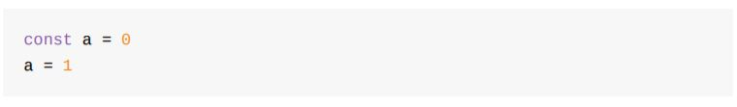
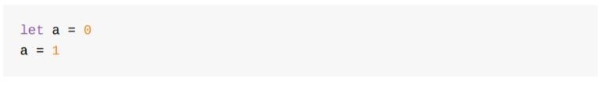
JaVAScript Concepts
Semicolon :
Every line in JavaScript is optionally terminated using Semicolons.
Values :
A ‘hello’ is a string value while 15 is a number.
Variables :
A variable is a value assigned to an identifier, for later reference in program.
Variables are loosely typed.
There are 3 ways to declare variable:
Var
Const
let

Slide 10
JaVAScript Concepts
Types:
Variables in JavaScript is untyped.
Two main types:
Primitive Types – Numbers, String, Boolean
Object Types – Methods, properties
Expressions :
An expression is a single unit of JS code that JS engine can evaluate and return a value
They are as follows:
Primary expressions – this, 2, 2.02, ‘hello’, true, etc
Arithmetic expressions – i/2, i*5, i++, i-=2, etc
String expressions – ‘A’ + ‘string’
Logical expressions – a&&b, a||b, !a, etc
More advanced expressions – objects, functions & arrays

Slide 11
JaVAScript Concepts
Operators :
It allows you to combine two expressions to form more complex expression.
Few operators are as follows:
Assignment Operator – ‘ = ‘ eg: let b = 2
Addition Operator – ‘ + ‘ eg: const four = 3 + 1
Subtraction Operator – ‘ – ‘ eg: const two = 4 – 2
Division Operator – ‘ / ‘ eg: const result = 20 / 2
Remainder Operator – ‘ % ‘ eg: const result = 20%5.
Here remainder by zero returns NaN.
Multiplication Operator – ‘ * ‘ eg: const minusTwo = -1 * 2
Exponentiation Operator – ‘ ** ‘ eg: 2 ** 8 = 256
Precedence:
Let a = 1 * 2 + 5 / 2 % 2 = 2.5
1) * / % 2) + - 3) =

Slide 12
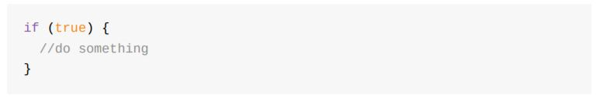
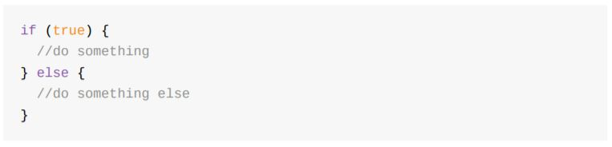
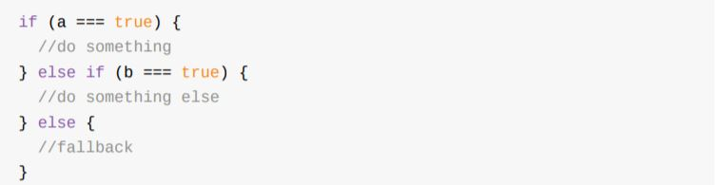
JaVAScript Concepts
Comparisons :
Comparison operator always returns a boolean.
< , <= , > , >= , == , != , === , !==
Conditionals :

Slide 13
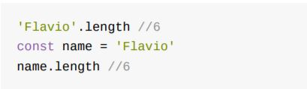

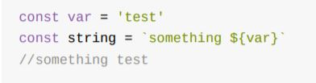
JaVAScript Concepts
Strings :
A string is a sequence of characters.
‘ ‘ , “ “ , ` `
Length property :
2. +, $ operator to interpolate strings:

Slide 14
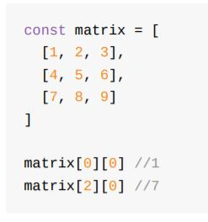
JaVAScript Concepts
Arrays :
Arrays are collection of elements or Objects.
Initialization - 2 ways:
Const a = [ ] , const a = [1, 2, 3]
Const a = Array( ) , const a = Array.of (1, 2, 3)
Arrays can hold any values even different types.
Eg: const a = [1 , ‘Hello’ , [‘a’, ‘b’]]
Multidimensional Array
5. Add item to Array:
Push( ) – at last eg: a.push(6)
Unshift( ) – at the beginning eg: a.unshift(0)
Remove item from an Array:
Pop( ) – from last eg: a.pop ( )
Shift ( ) – from the beginning eg: a.shift ( )
Find a specific element in array
Find( )
findIndex( )
Includes( )

Slide 15
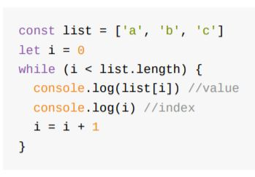
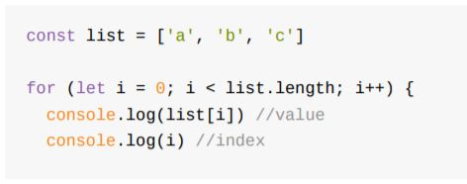
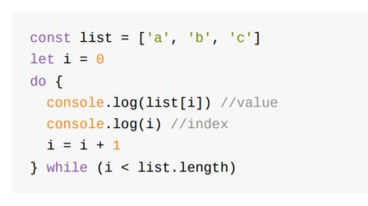
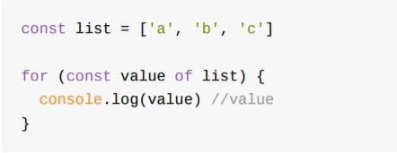
Javascript Concepts
LOOPS:
While :
Do while :
For :
For .. Of :

Slide 16
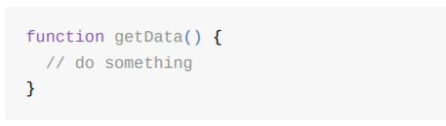
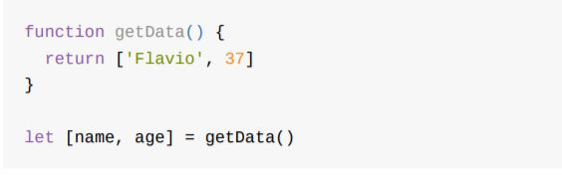

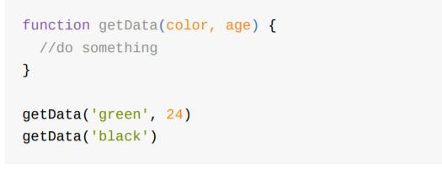

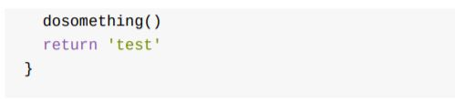
Javascript Concepts
Functions: It is a block of code, self contained.

Slide 17
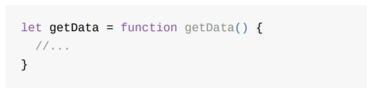
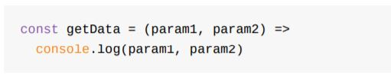
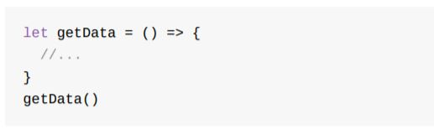
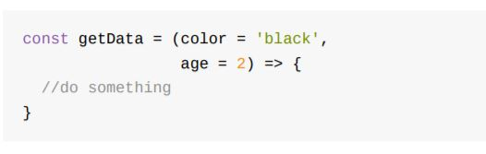

JAvaScript Concepts
Arrow Functions :
They are used in replacement to ‘regular’ functions to write functions with short syntax.

Slide 18
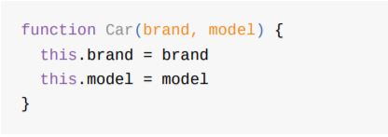

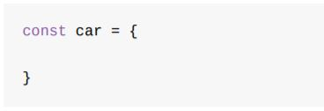
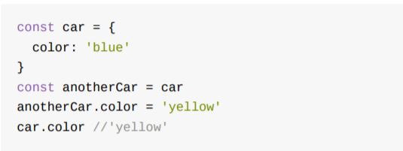


JAvaScript Concepts
Objects :
Any value that's not of a primitive type (a string, a number, a boolean, a symbol, null, or undefined) is an object.
Define an Object :
2. Create an Object :
3. Initialize an Object :
4. Objects are always passes by reference

Slide 19

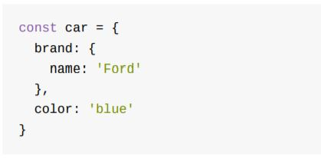
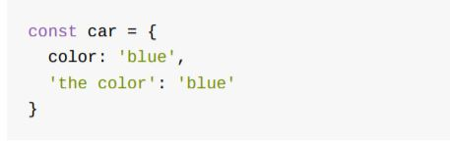




Javascript concepts
Object Properties :
It is the label associated with a value.
The value of the property can be of any type like, array, a function, even objects (nested Object)

Slide 20
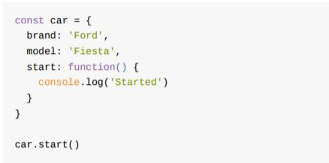
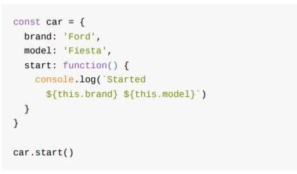
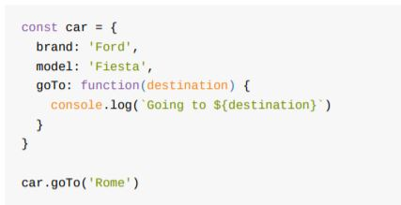
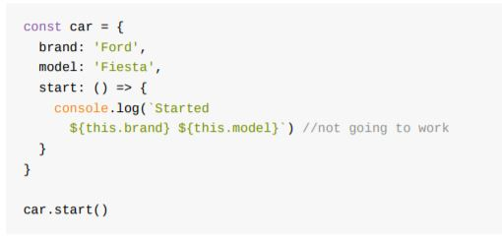
Javascript ConceptS
Object Methods :

Slide 21
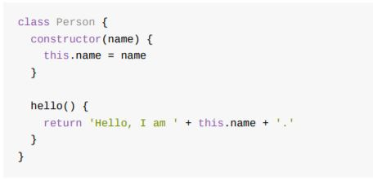



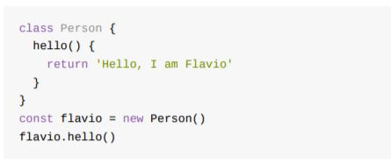
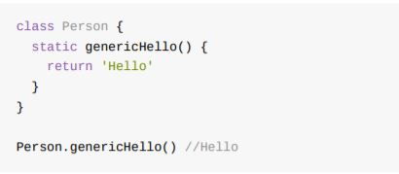
JAvaScript Concepts
Classes :
They are a way to define a common pattern for multiple objects.

Slide 22
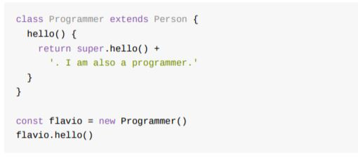
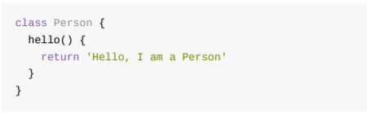
Javascript concepts
Inheritance :
A class can extend another class, and objects initialized using that class inherit all the methods of both classes.
The above program prints Hello, I am a Person. I am also a programmer..

Slide 23


Let’s start Coding

Slide 24
Memory game
Things we are going to cover:
Push ( )
querySelector ( )
setAttribute ( )
getAttribute ( )
createElement ( )
appendChild ( )
Math.random ( )
Sort ( )
For loops

Slide 25
references
Book – The JavaScript Beginner Handbook – by Flavio Copes
Website – JavaScript W3Schools Tutorials
Website – www.freeCodeCamp.org
Book – You Don’t know JavaScript

Slide 26

Thank You!
Contact - https://www.linkedin.com/in/kruti-patel-084642140

